Slide 1
We will begin the webinar shortly…
LIFELINKcentral™ AED program manager
Live webinar
This webinar will be recorded and available on AED Hub to review at your convenience.

Slide 2
LIFELINKcentral™ 101
Shalini Majumdar

Slide 3
Agenda
Review account types and privileges
LIFELINKcentral navigation tabs
How to create customer accounts
Live demo
What intro emails look like
How to update accounts, sites, primary coordinators, training requirements
Device transfer

Slide 4
Account types and privileges

Slide 5
LIFELINKcentral account types
ASR
Basic
Limited portal view
Only for connected AEDs
Full portal view promotion ended March 31.
Advantage
Full portal view
Full white glove service from Stryker
Distributor
Customer
Premium
Type 1
Type 4
Internal Stryker admin, full access
Full portal view
Additional features but no dedicated ASR support
Track
Full portal view
Dedicated ASR, up to 50 devices
Type 2
Default distributor account Ability to add customer accounts and transfer devices
Private license (paid offering) Full access to LIFELINKcentral
Master distributor account Ability to transfer devices to sub-distributor accounts
Ability to rebrand, create custom packages for customers, add devices for customers
Program Coordinator
Site Coordinator
AED Trained Responder
AED Inspector
Distributor Account Admin

Slide 6
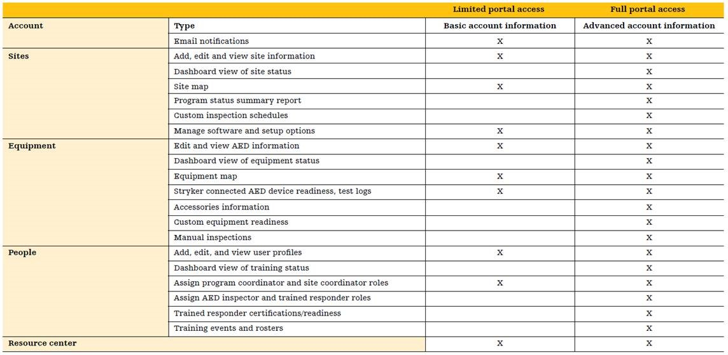
Limited vs. Full portal access

Slide 7
Navigation tabs

Slide 8
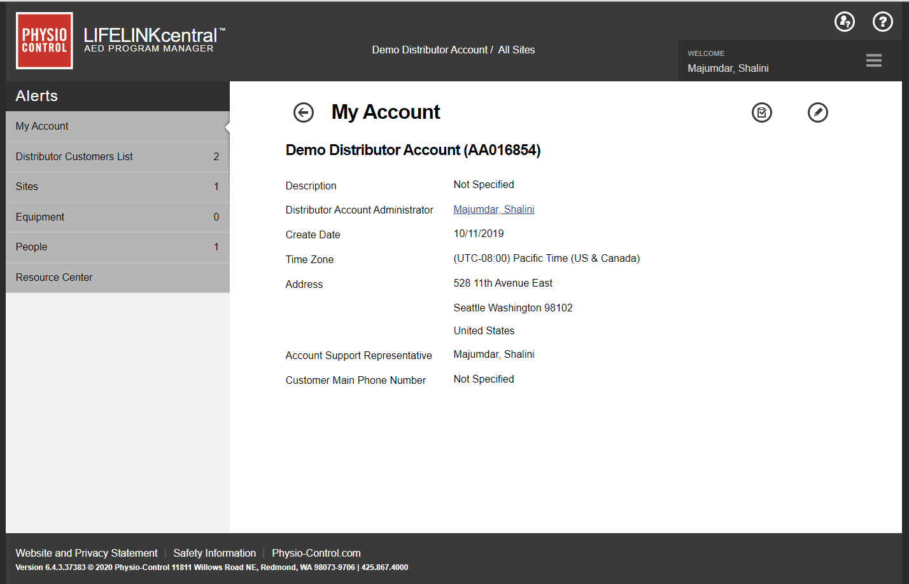
Live demo
Notes:
Switch to LIFELINKcentral. Walk through what each tab provides.
My Account tab has summary for the distributor account
Emphasize how after clicking on “distributor customers list” all tabs below are associated with the customers.
Show the different sites, equipment tabs, and people.
Go back to “My Account” and show how it’s different from what we just saw on the customer end
Explain what is in the resource center

Slide 9
Creating customer accounts

Slide 10
Live demo creating customer accounts
Show Distributor Customers List tab and customer accounts
Select the Add Account button
Talk through each section and fill out required fields
Submit and show newly created customer account with program coordinator
Add additional sites

Slide 11
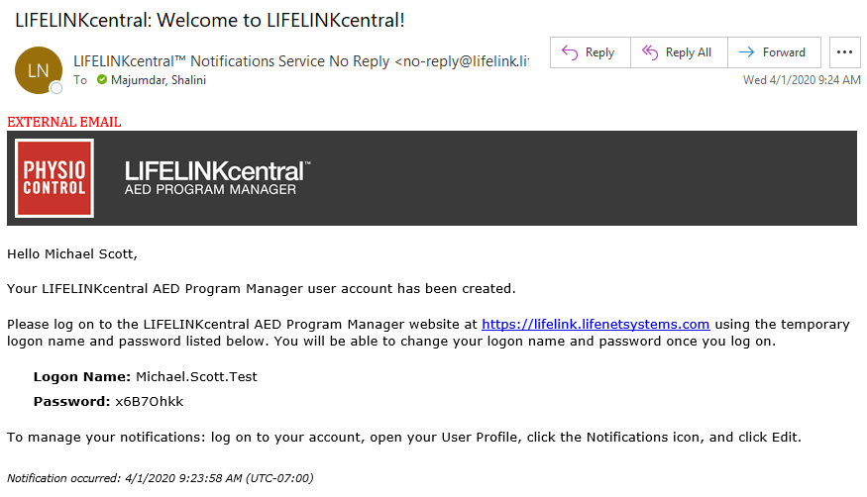
Welcome email

Slide 12
Live demo editing account settings
Navigate to Distributor Customers List
Select a customer account
Update training requirements
Update primary program coordinator
Update site details

Slide 13
Device transfer

Slide 14
Live demo transferring devices
Show Distributor Customers List tab and customer accounts
Show Equipment tab with LIFEPAK® CR2 AED devices
Transfer devices to Demo Customer Account
Show transferred devices in Demo Customer Account Equipment tab

Slide 15
Questions?

